Slide 1
Who is Garrett morgan? March 4, 1877 – July 27, 1963
Student health & human services
Office of human relations, diversity & equity
July 2022
Notes:
Dear teacher, thank you for choosing to share this Advisory Lesson with your class. The Office of Human Relations, Diversity & Equity wants to remind all educators of the importance of teaching Black History all year long. February is a month to celebrate, amplify and recognize Black history. But students must understand that Black history is world history, and should be taught as such.

Slide 2
Would you rather...
Sew your own clothes?
Grow your own food?
Notes:
Please invite the students to engage in the check in question.

Slide 3
objectives
Learn about the inventions of Garrett Morgan
Discuss the backlash he received for being Black and the relevance to today's society
Identify the importance of Garrett Morgan
Notes:
Read the objectives aloud for the students – remind students of classroom norms.

Slide 4
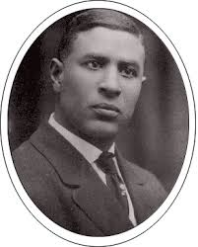
The early years
In 1877, Garrett Morgan was born to formerly enslaved people in Claysville, Kentucky, an almost exclusively African-American community.
He attended school up to 6th grade, then moved to Cincinnati, Ohio at 14 to find work.
Morgan spent most of his teenage years working as a handyman for a landowner.
He was able to earn enough money to hire a tutor to continue his studies.
Notes:
Read the slide aloud for the students.

Slide 5
the start
In 1895, Garrett moved to Cleveland, where he started fixing sewing machines for a clothing manufacturer and he earned a strong reputation.
This led to his first invention: a belt fastener for sewing machines.
In 1907, Garrett opened his own sewing machine shop.
In 1909, he and his wife, Mary Anne opened Morgan's Cut Rate Ladies Clothing Store
Notes:
Read the slides aloud for the students.

Slide 6
the first inventions
1910
In 1910, Garrett became more interested in developing his own inventions.
1912
In 1912, he received his first patent.
1913
In 1913, Garrett he invented a hair straightening comb, and patented hair straightening cream. G.A. Morgan Hair Refining Company was born and sold these hair products.
Notes:
Read the slide aloud for the students.

Slide 7
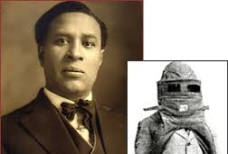
the smoke hood
In 1912, he received a patent for his smoke hood design, which he invented after seeing firefighters struggling from the smoke they encountered in the line of duty.
In 1914, he launched the National Safety Device Company to market it.
He was able to sell his invention around the country, sometimes using the tactic of having a hired white actor take credit rather than revealing himself as to its inventor.
His invention became known nationally when he led a rescue that saved several men's lives after a July 24, 1916 tunnel explosion under Lake Erie.
Notes:
Read the slide aloud for the students.

Slide 8
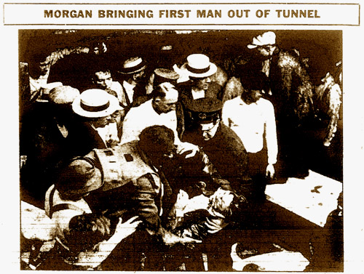
backlash
Cleveland's newspapers and city officials initially ignored Morgan's act of heroism as the first to rush into the tunnel for the rescue and his key role as the provider of the equipment that made the rescue possible, and it took years for the city to recognize his contributions.
City officials requested the Carnegie Hero Fund Commission to issue medals to several of the men involved in the rescue, but excluded Morgan from their request.
He believed that the omission was racially motivated.
Notes:
Read the slide aloud for the students.

Slide 9
backlash
After the heroic rescue Morgan's company received order requests from fire departments all over the country. However, the national news contained photographs of him, and officials in a number of southern cities canceled their existing orders when they discovered he was Black.
In 1917, a group of citizens of Cleveland tried to correct for the omission by presenting him with a diamond-studded gold medal.
He was also given a medal from the International Association of Fire Engineers, which made him an honorary member.
Notes:
Read the slide aloud for the students.

Slide 10
Time to share
The backlash against Garrett Morgan due to being Black, occurred in 1916. Several race motivated movements and campaigns have occurred since then. In this era, the Black Lives Matter Movement is well underway.
How far do you think we've come regarding racism? How far do you think we still need to go?
Notes:
Invite the students to engage in the reflection question.

Slide 11
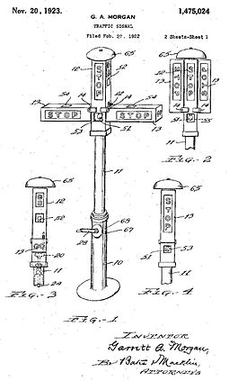
Traffic signal
In 1922, Morgan filed a patent for a traffic control device having a third "warning" position in 1922.
In 1923, the patent was granted.
Notes:
Read the slide aloud for the students.

Slide 12
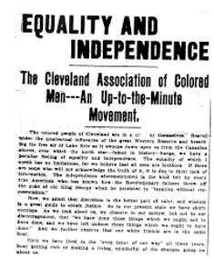
Community leadership
In 1908, he co-founded the Cleveland Association of Colored Men, which later merged with the National Association for the Advancement of Colored People.
in 1920, founded the Cleveland Call, a weekly newspaper and, in 1938, subsequently participated in its merger that created the Cleveland Call and Post newspaper.
Morgan purchased a farm near Wakeman, Ohio, and upon that land built the Wakeman Country Club, open to Blacks, unlike most country clubs then.
Notes:
Read the slide aloud for the students.

Slide 13
Black history: remembering garrett morgan
Notes:
Play the video for the students. (2:56)
https://www.youtube.com/watch?v=4E6WPNahGK0&feature=emb_title

Slide 14
Time to share
If you could invent something that would improve society, what would it be?
Notes:
Engage the students in the reflection question

Slide 15
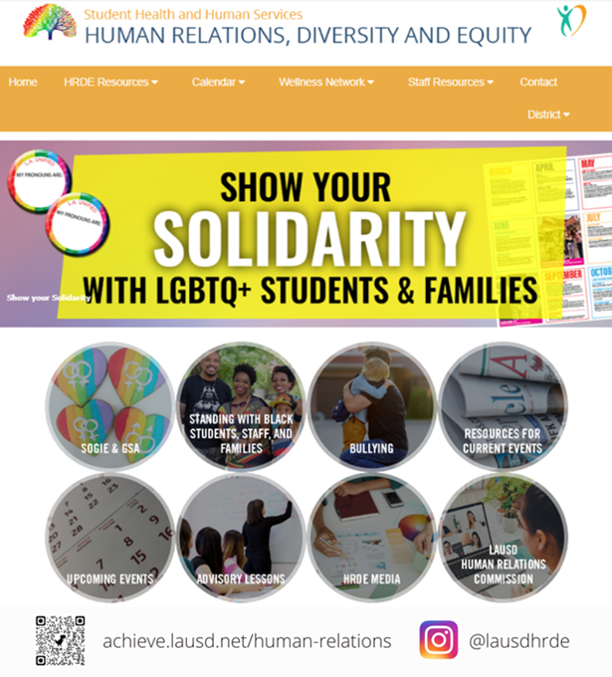
Human relations, diversity & equity

Slide 16
Teacher Feedback
Notes:
Teacher please complete a brief feedback form by scanning the QR code or using the link below
https://forms.office.com/r/i9UqyyxzTT

